Slide 1
Energy Tuning Assembly Scope and Design
Current Shot Date: 7/23/17
Carlos Esquivel
Mechanical Engineer
January 31, 2018

Slide 2
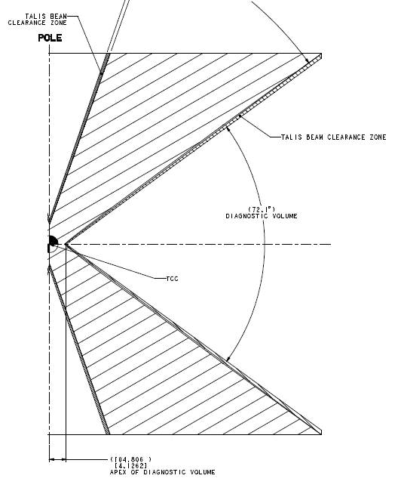
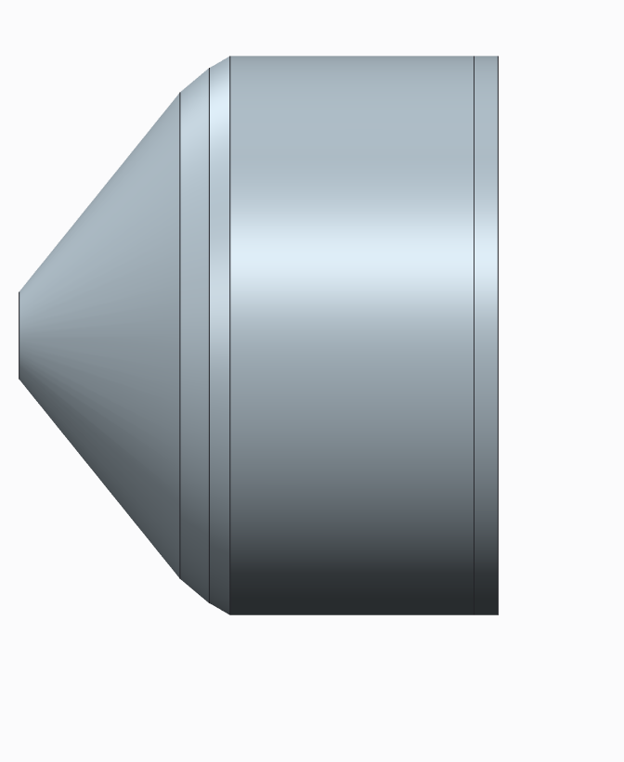
ETA Overview:
ETA (Energy Tuning Assembly) contains a payload of HEU (Highly Enriched Uranium) along with other ride-along materials
The payload is contained within a removable drawer
The snout is tentatively set at a SOD of 15cm from the front face.
15cm
ETA
SAA12-101128

Slide 3
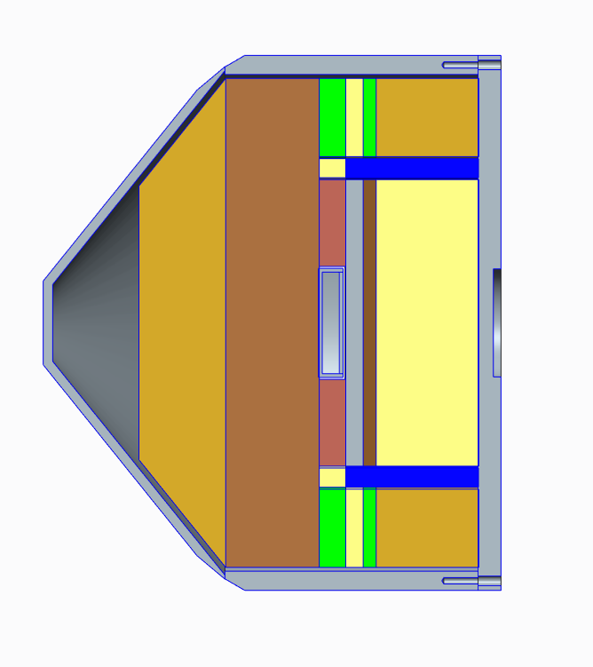
ETA Overview:
The internal ETA components include: Cast Bismuth, Tungsten, Praseodymium, Silicon, and Boron Carbide
Estimated weight of assembly is approx. 71 kg
Snout will be installed on TANDM 90-124

Slide 4
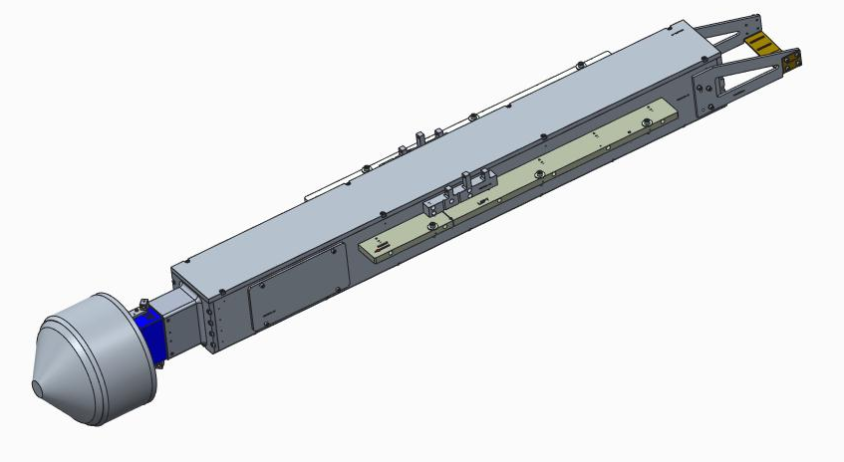
Current Design Scope:
Due to the type of materials carried inside the snout, the casing needs to be hermetically sealed. Current casing design is not hermetic.
The weight of the snout (71kg or 156 lbf) will require the use of a lifting device. Lift features need to be added to the case design.
ETA Snout shown on TANDM Airbox

Slide 5
Other thoughts
Are there requirements for assembling rad materials?
This (ridealong) version will be free-released from LBL prior to build. Therefore, we can handle it in B391.
The physics payload (HEU Toad) movement must be coordinated with LLNL Materials Management.
Retroreflectors are hidden by snout, we may need a new retro design or position them on snout
Others?...

Slide 6
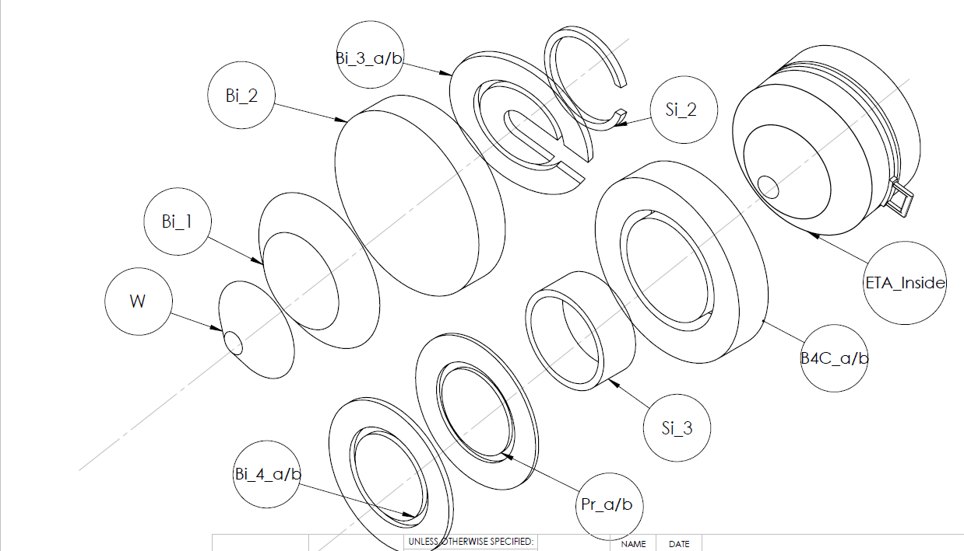
Materials used in ETA Assembly

Slide 7
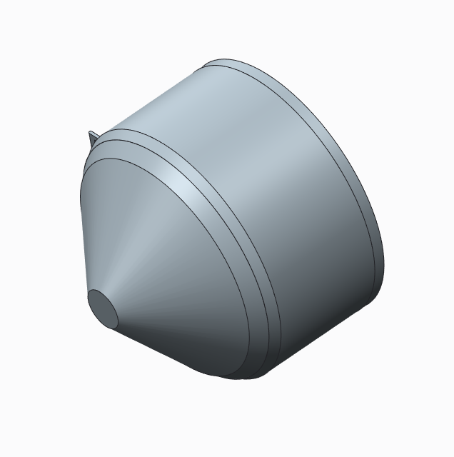
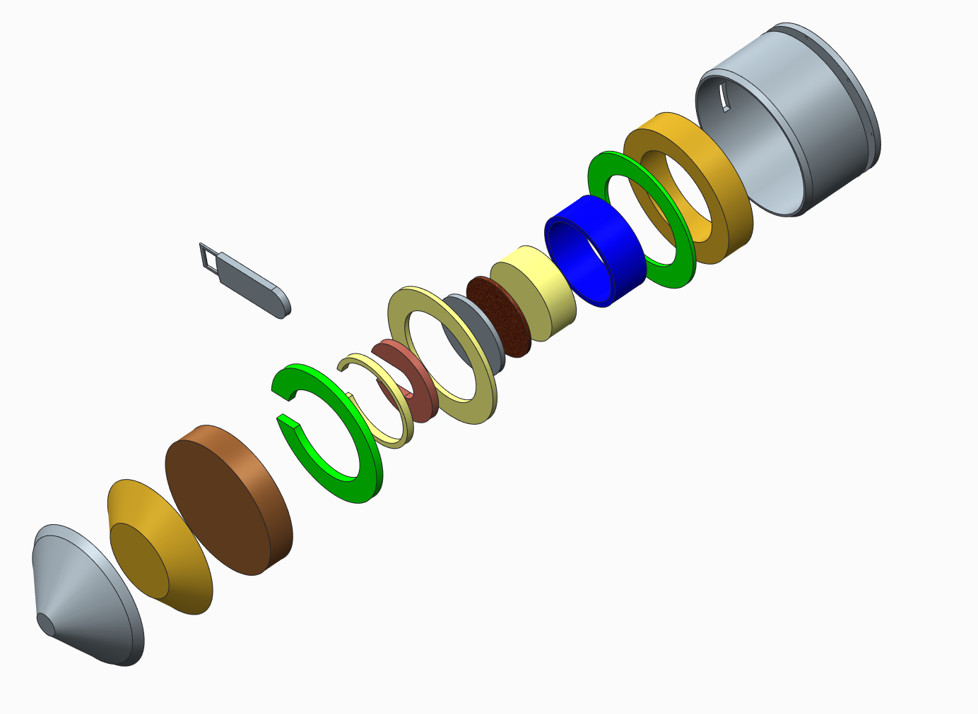
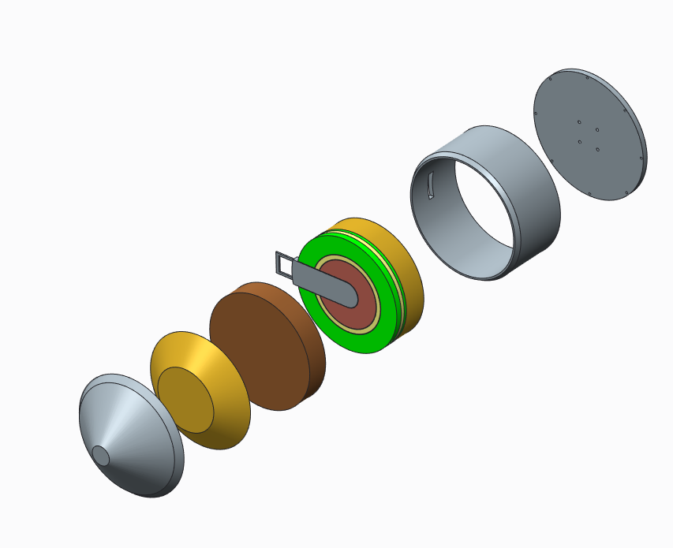
Exploded View of ETA Assembly

Slide 8
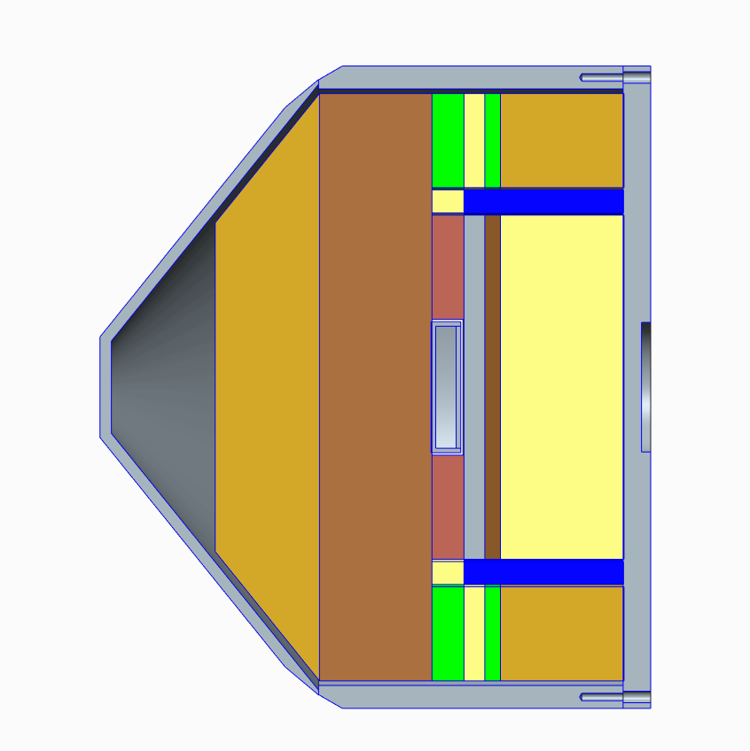
Bismuth Parts SODs, and mass
Bi_3_a,
3.43kg
Bi_3_b, 1.63kg
144.2mm
95.6mm
~150mm
50.2mm
Total Bismuth Mass = 48.1kg
TCC
Bi_2
Bi_1
24.7kg
14.3kg
158.5mm
Bi_4_a,
2.47kg
Bi_4_b,
1.58kg

Slide 9
HEU and Praseodymium Parts SODs, and mass
Pr_a,
1.27kg
Pr_b,
.81kg
HEU, 2.2 g or less?
167.6 mm
~150mm
Total Praseodymium Mass = 2.08kg
TCC
144.2 mm

